Slide 1


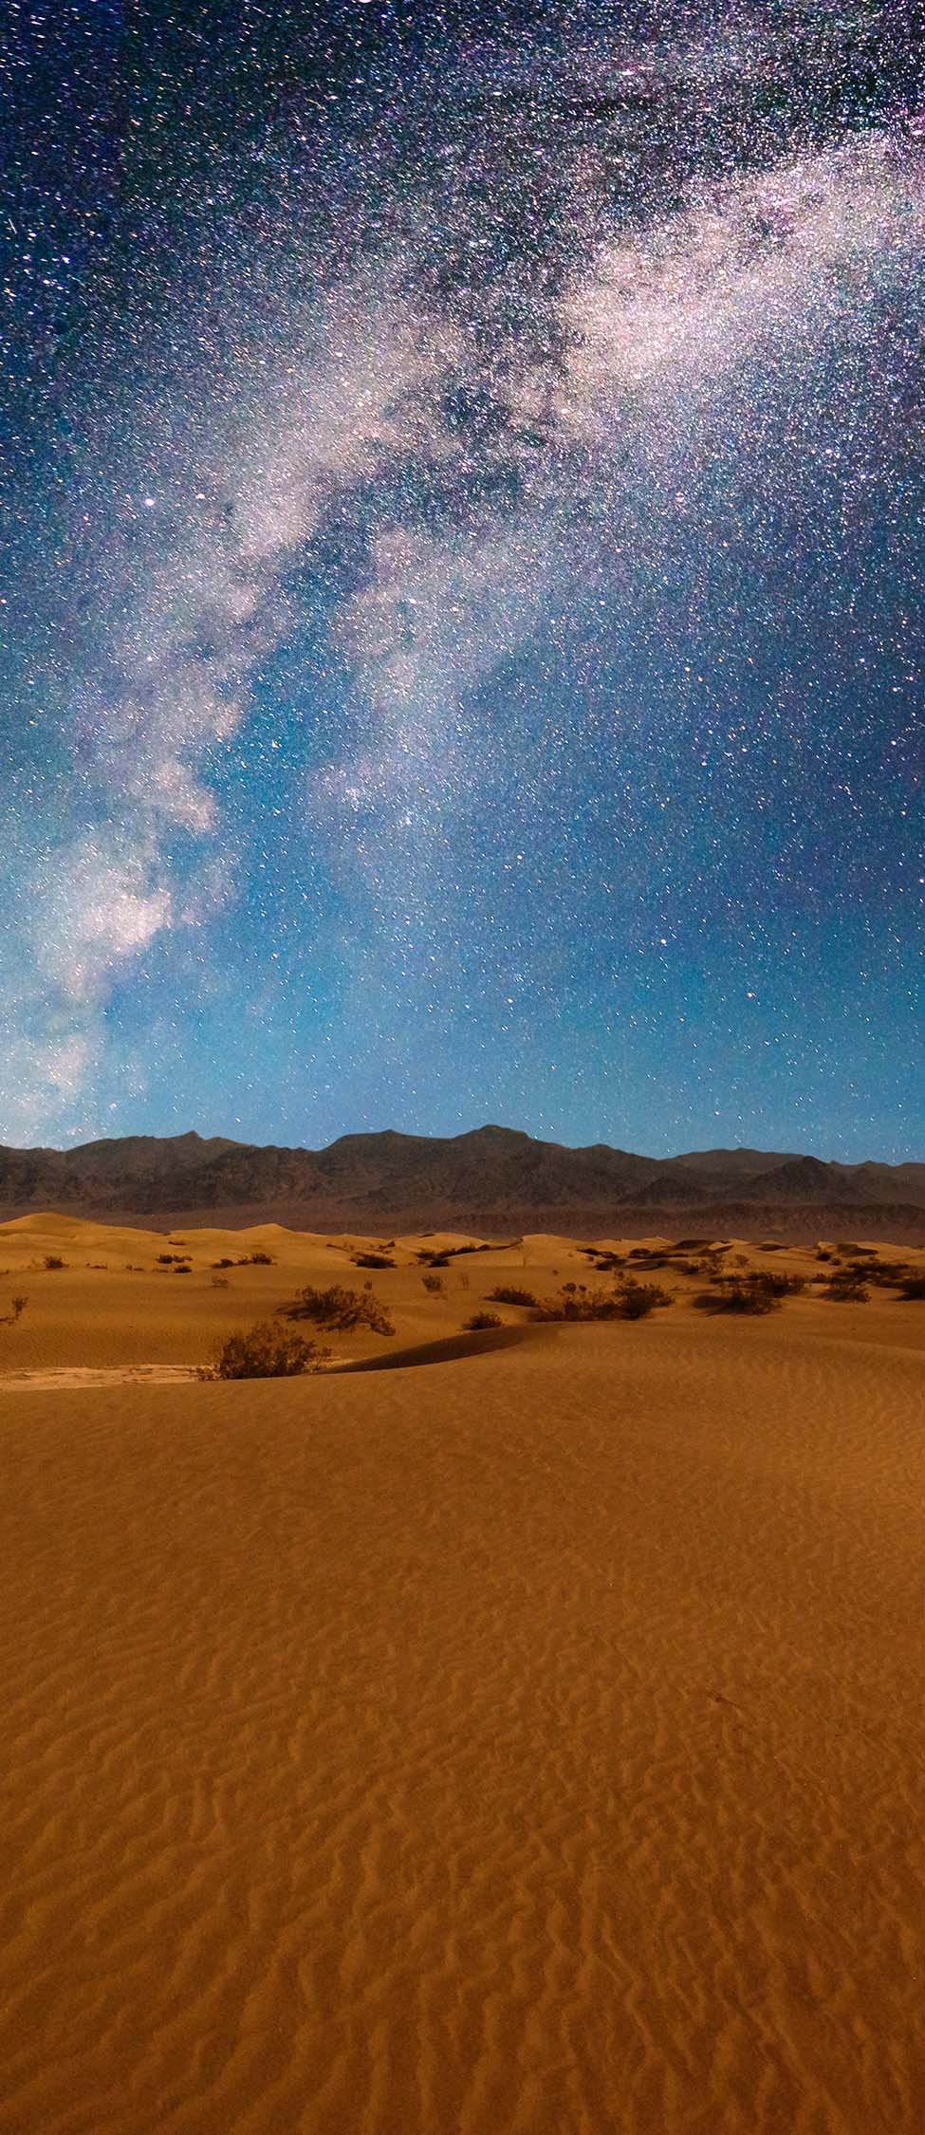


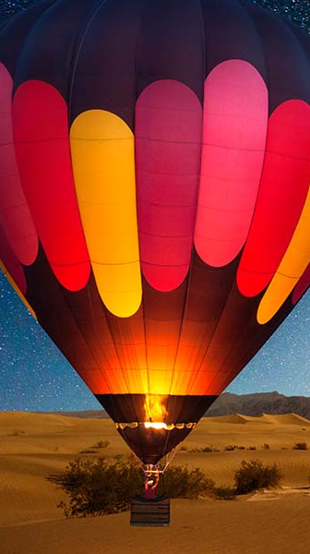
Slide 1
FRIEND, FAMILY, AND TRAVEL DAIRY(FFTD)

Slide 2

TEAM MEMBERS:
Devineni Naga Sravya
Srihari Meka
Duggirala Abhishek
Goyani Shivani Bipinbhai
Vishnu Sai Bollam
Vishnu Vardhan Reddy
Rithvik Golthi

Slide 3
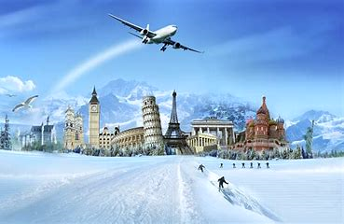
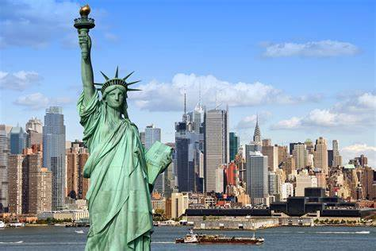
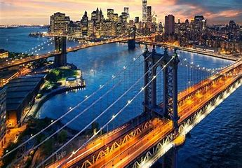
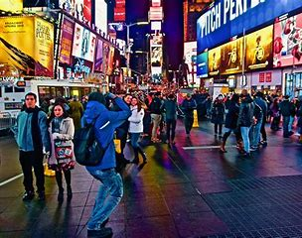
PROJECT DESCRIPTION:
Our website is a travel diary where we can post our vacation memories. We can also choose who can see our posts, like whether family members can see the post or friends. We can also post the pictures by creating events or places in the events link and travel link respectively so that it will be easy to filter out the pictures to any one of them. Your friends and family can comment on the posts.

Slide 4
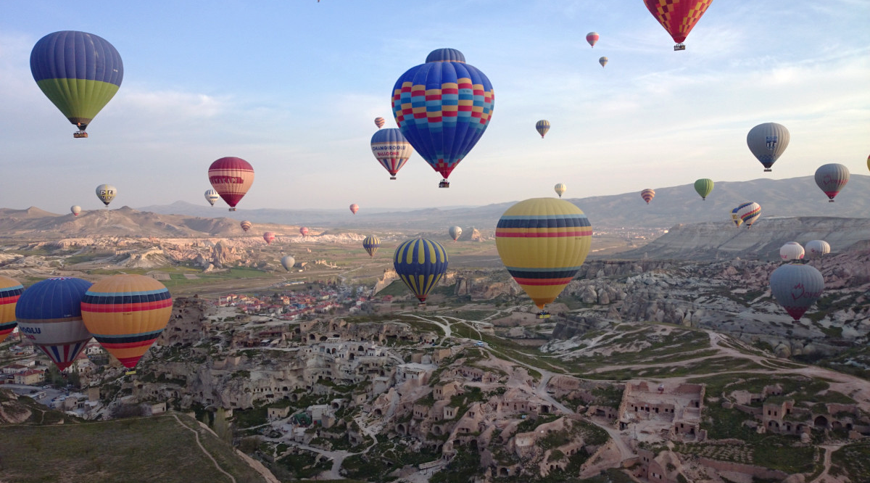
Slide 1
PROJECT BACKLOG
SPRINT-1
Db setup
Registration
Login
Forget password
SPRINT-2
Access rights management
Family ancestry link
Friend history link
SPRINT-3
Events link
Travel link
“Just happened” link
SPRINT-4
Bucket list link
Dynamic content update
Testing functionality
SPRINT-5
Bug fixing
System testing
Documentation

Slide 5
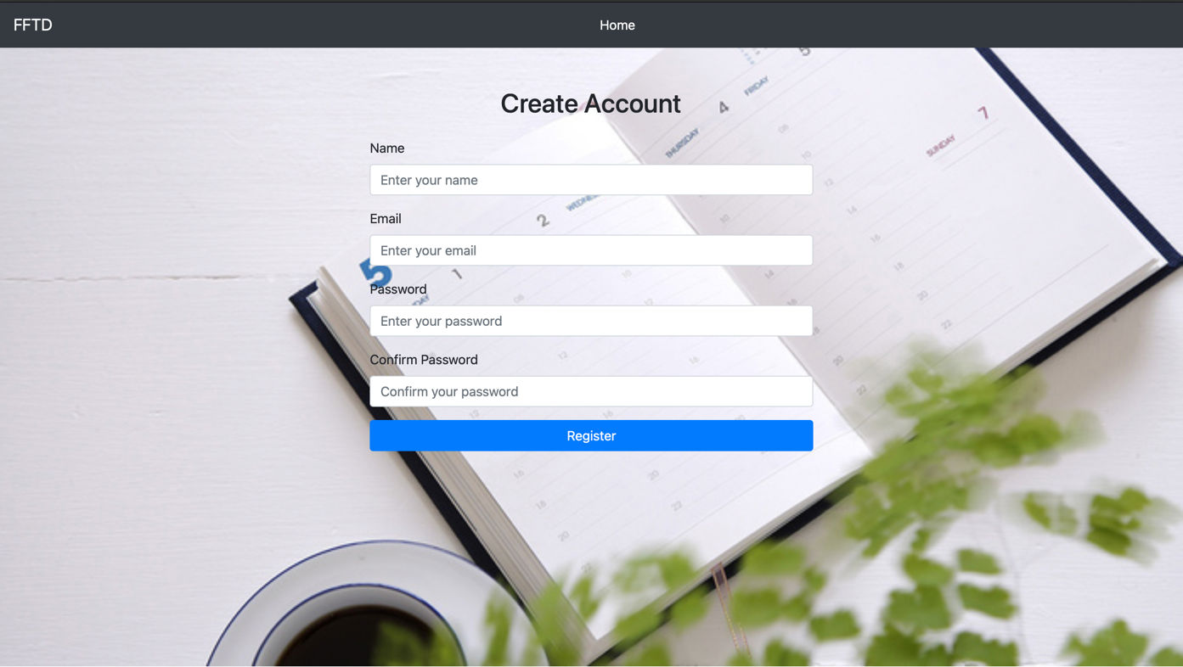
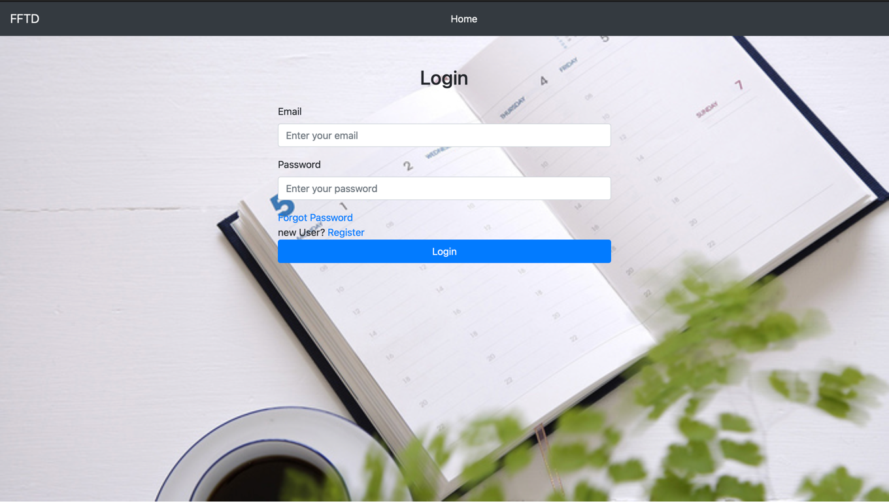

Slide 6
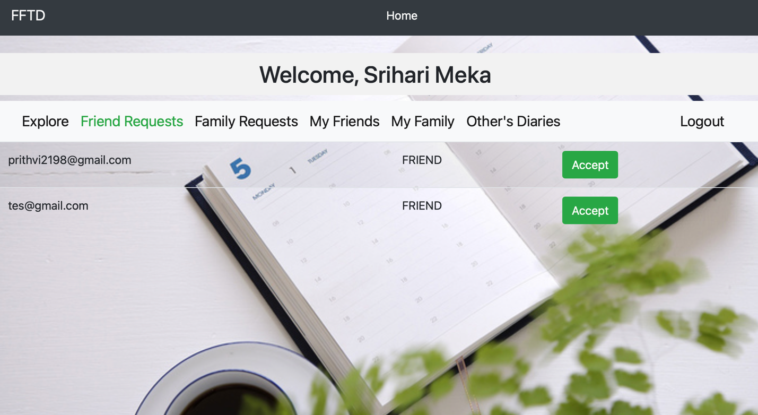
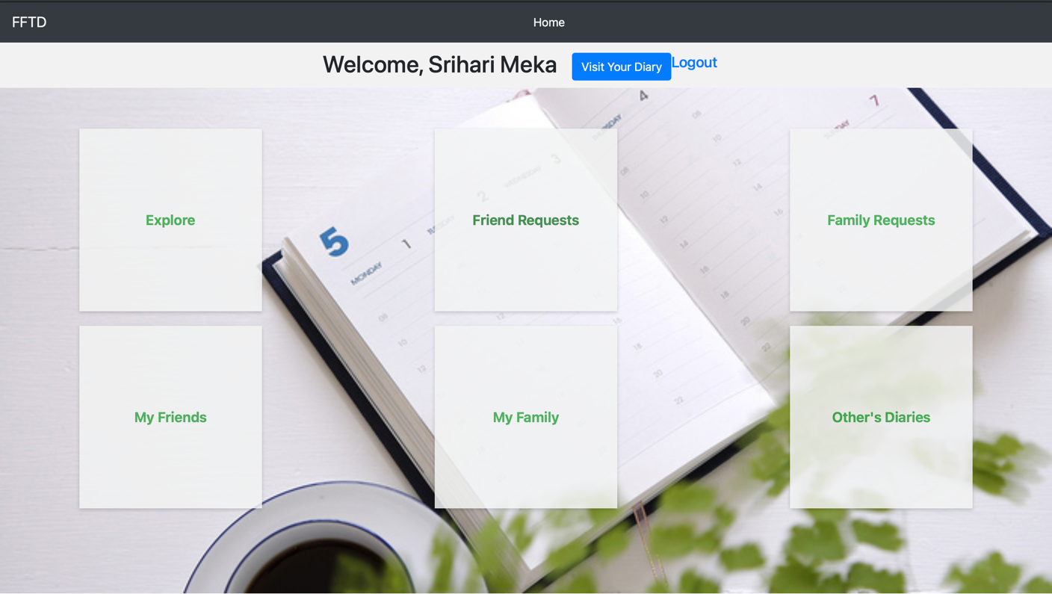
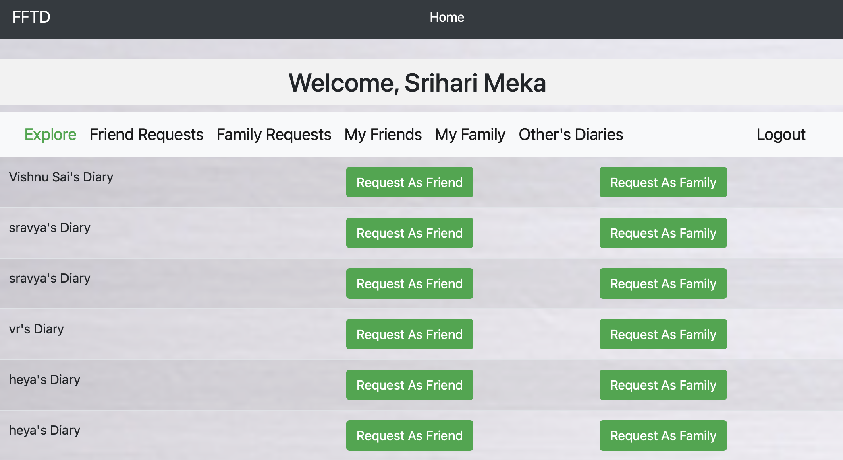

Slide 7
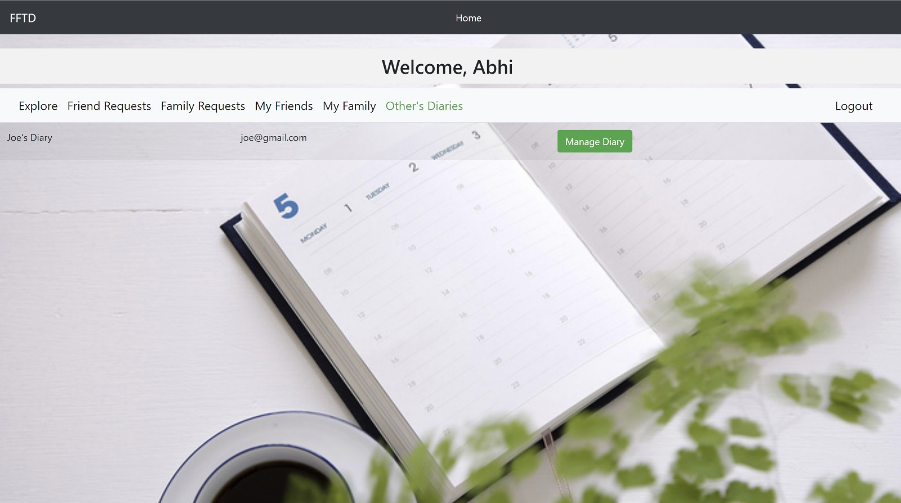
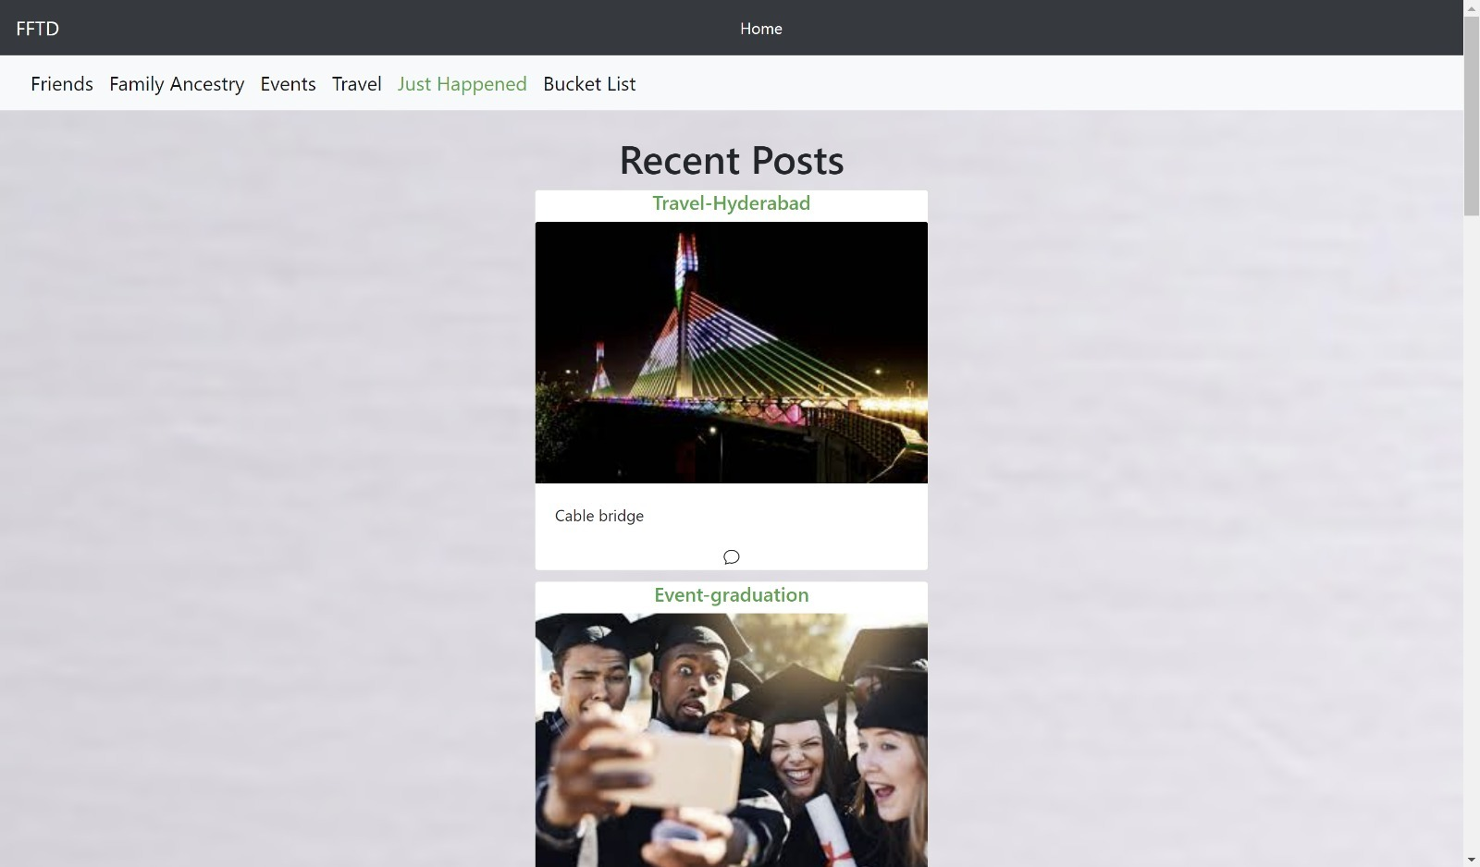
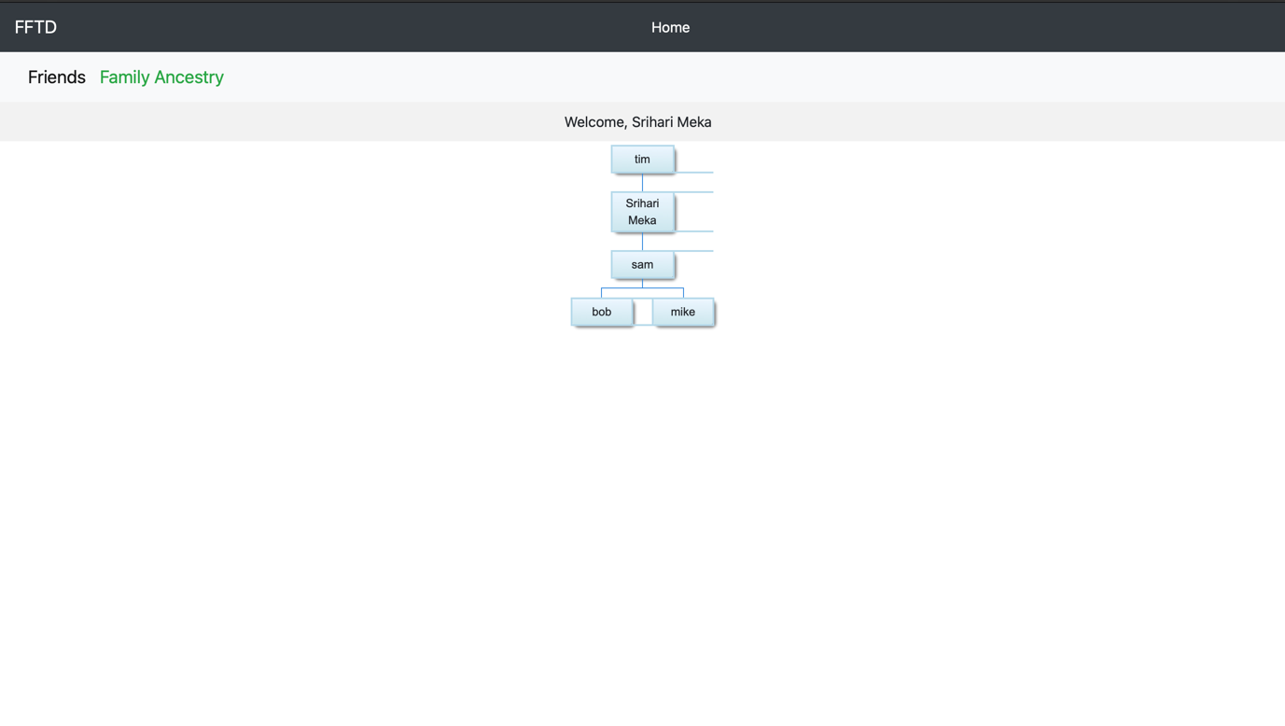
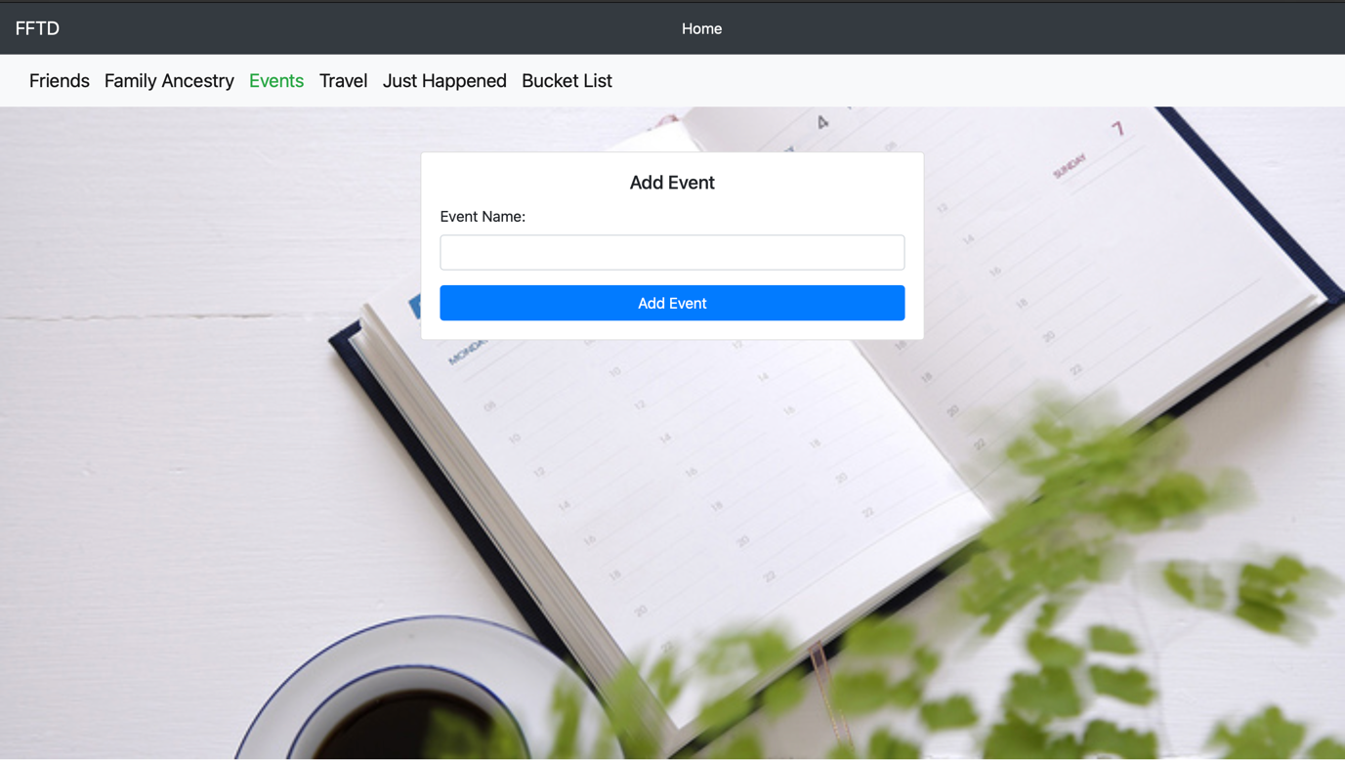

Slide 8
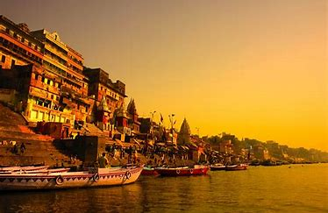
MAIN OBJECTIVES:
Share pictures and videos
Connect with friends and family
Traveling places and storing memories
Characterizing events for every post
Easy to filter the places we travel to and their respective pictures.
Have a bucket list of places we want to explore in life
Separate friends and family access

Slide 9

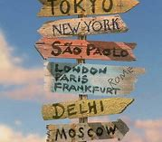

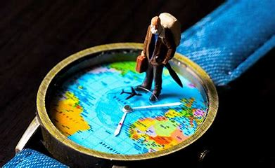
FUTURE SCOPE
MOBILE APPLICATION
PERSONALIZE ADDS
TO BE HANDY AND ACCESS ANY WHERE.
PERSONALIZING OPTION FOR THE PLACES THAT ARE ADDED TO THE BUCKET LIST.
SHORT VIDEOS
NOW-A-DAYS IT IS TREND TO MAKE SHORT VIDEOS AND SHARE.
MAP INTEGRATION
HELPS TO NAVIGATE PLACES AROUND THE TRAVELLING AREA.

Slide 10


Future support
We will monitor the analytics for the incoming traffic of the website, so whenever its needed we can implement load balancing and upgrade the hosting plan to handle the traffic.
It becomes frustrating if the user loses their data due to any issue, so will implement the backup time to time.

Slide 11
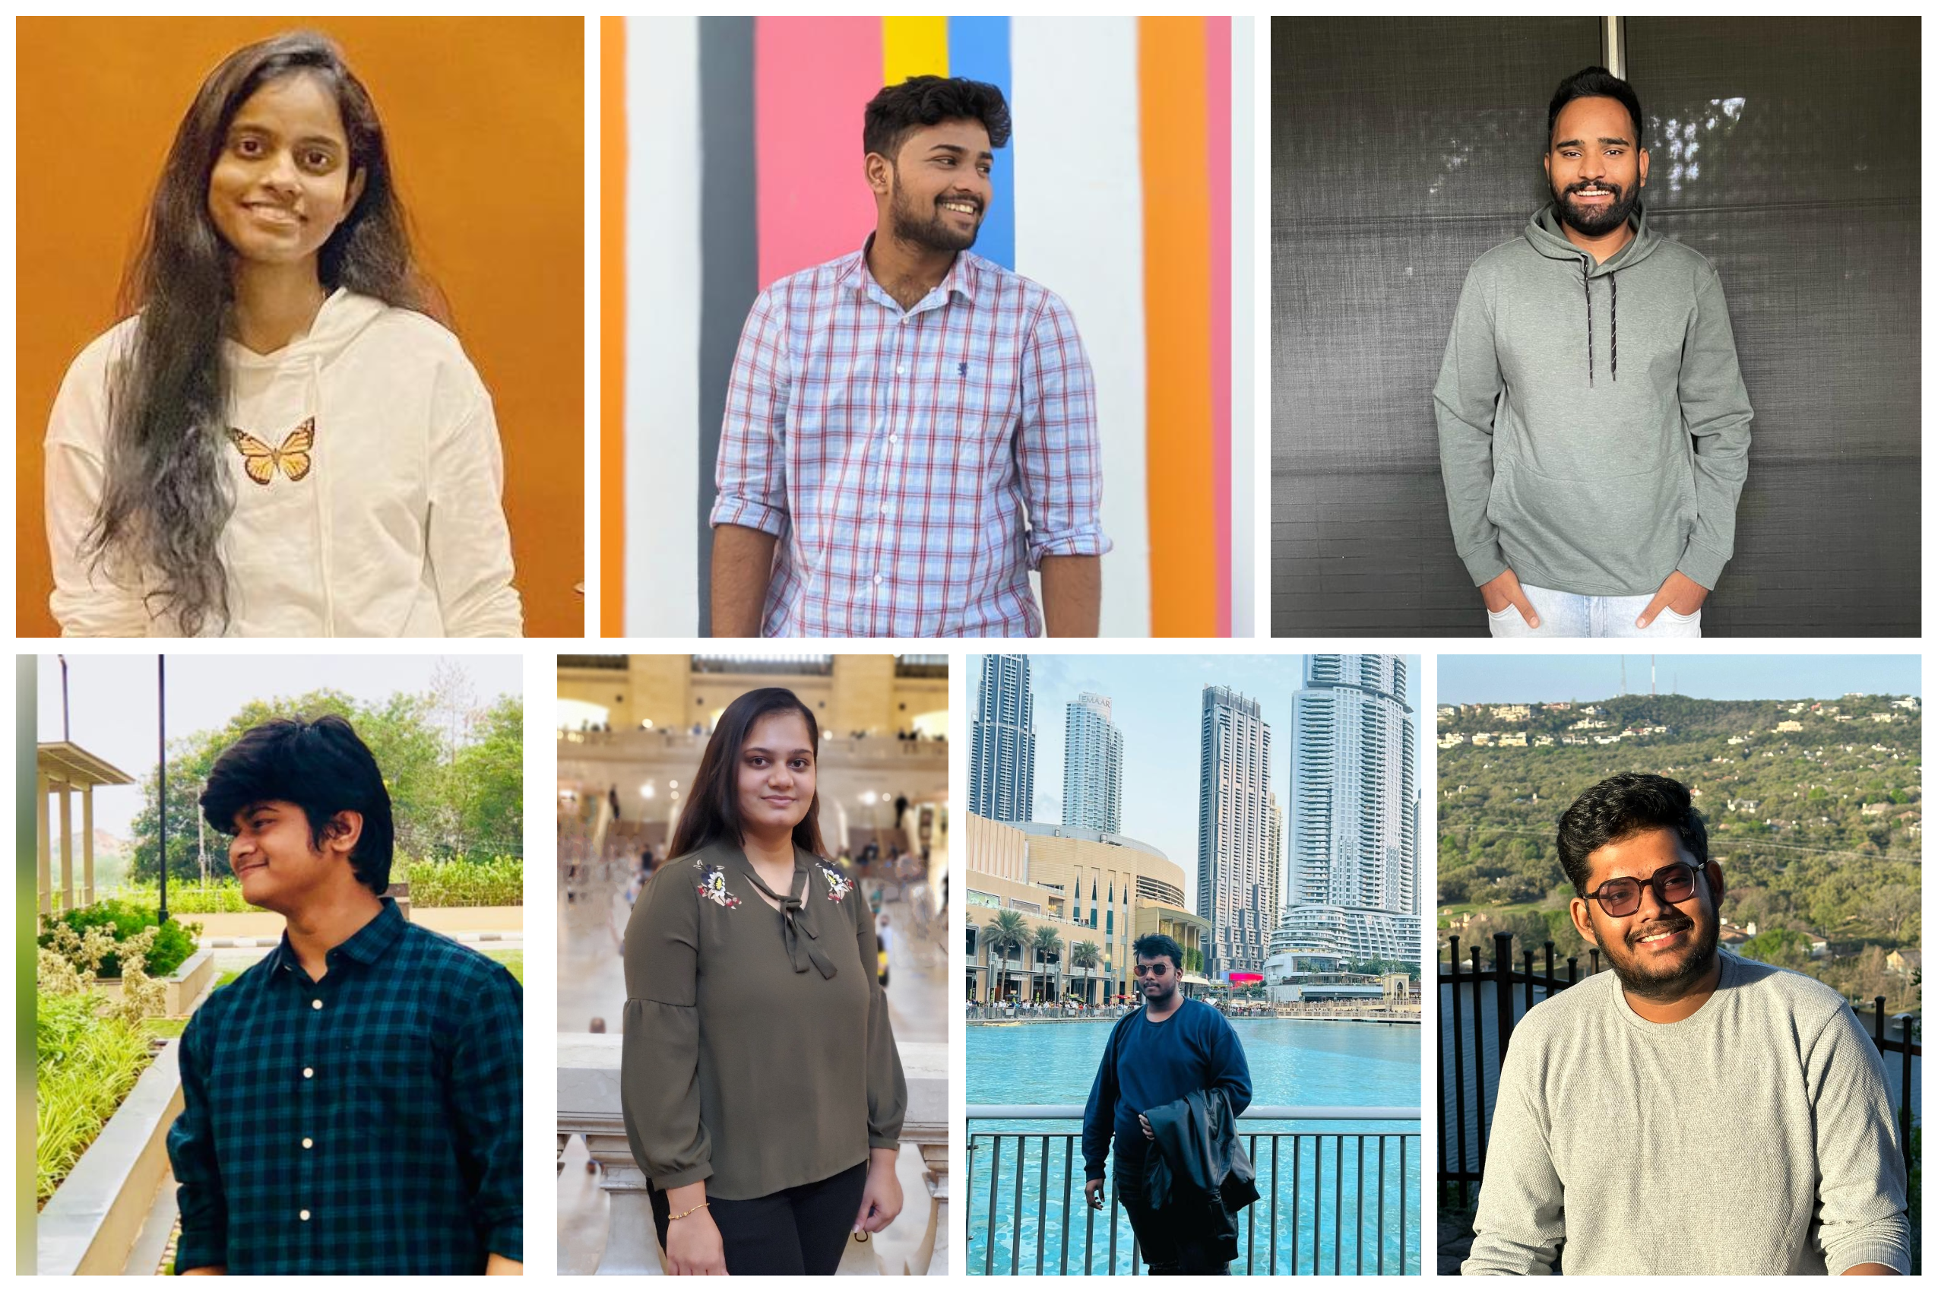
Devineni naga sravya
Srihari meka
Duggirala abhishek
Rithvik Golthi
Goyani Shivani Bipinbhai
Vishnu Sai Bollam
Vishnu Vardhan Reddy

Slide 12


